Slide 1

Financial Analysis
Task - 3
Presentation by:
Susmita khanra

Slide 2



CONTENTS
o1.
INTRODUCTION
o2.
PROBLEM STATEMENT
o3.
PROCESS
o4.
DASHBOARD
o5.
o6.
INSIGHTS
SUMMARY

Slide 3

INTRODUCTION
The financial analysis project aims to provide a comprehensive overview of the financial performance and market positioning of major Indian companies.
This analysis includes key metrics such as market capitalization and quarterly sales figures, offering valuable insights into the economic landscape and industry dynamics. The data highlights the dominance of certain sectors and companies, showcasing their impact on the overall market.

Slide 4

PROBLEM STATEMENT
Without analyzing the competition, it is difficult for a business to survive. You are tasked to analyse the competition for the management to provide better results. The data set has information on the market capitalization of the top 500 companies in India.
Serial Number , Name of the company ,Market Capitalization in Crores and Quarterly Sales in crores. Find key metrics and factors and show the meaningful relationships between attributes.
Objectives
Identify Market Leaders: Highlighting companies with the highest market capitalization and quarterly sales.
Analyze Sector Performance: Understanding the contribution of various sectors to the overall market. Assess Financial Heath: Evaluating the financial stability and growth potential to top companies.

Slide 5
PROCESS
DATA UNDERSTANDING
DATA ANALYSIS
DATA CLEANING
UNCOVERING INSIGHTS

Slide 6
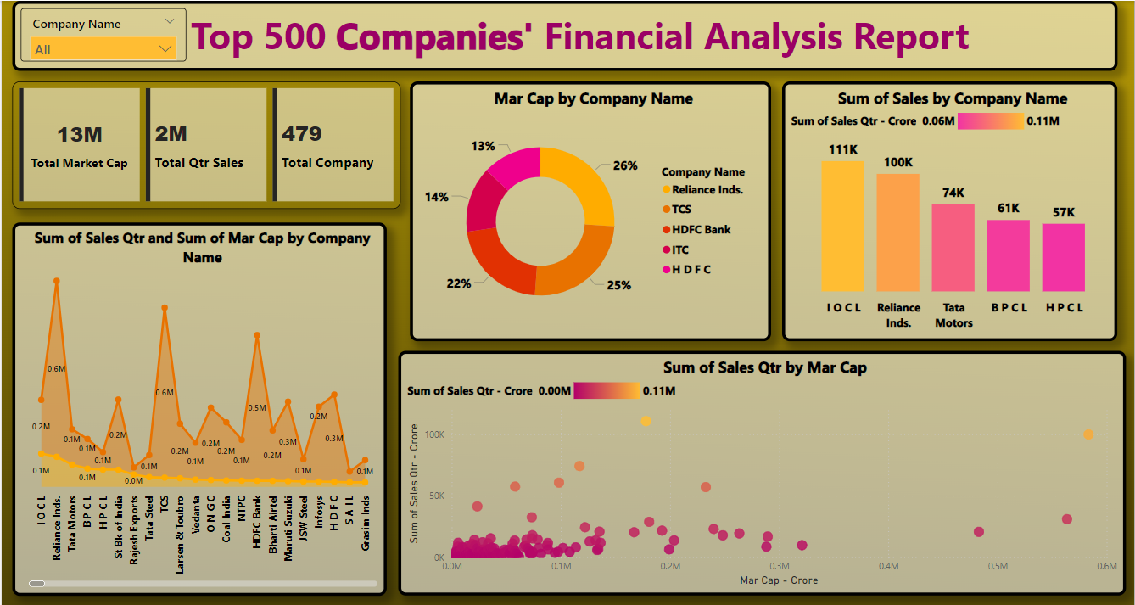
DASHBOARD

Slide 7

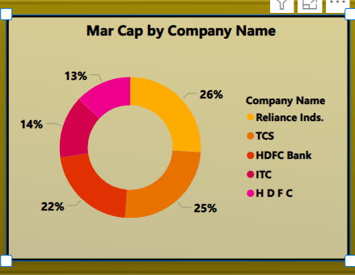
Top 5 Industries by Market Capitalization
INSIGHTS
Top 5 Industries by Market Capitalization
Reliance Industries- 583.44K
TCS ( Tata Consultancy Services)- 568.71k
HDFC Bank- 482.95K
ITC- 320.99K
HDFC- 289.5K
These companies dominate in terms of market capitalization, with Reliance Industries leading significantly.

Slide 8
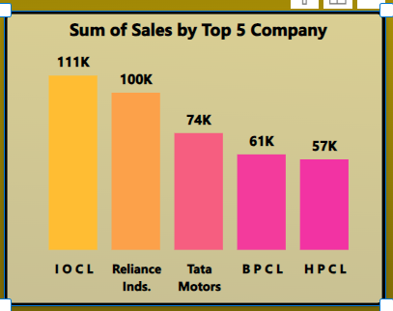
Top 5 Industries by Quarterly Sales
INSIGHTS
Top 5 Industries by Quarterly Sales-crore:
IOCL(Indian Oil Corporation Limited)-110,667
Reliance Industries-99,810
Tata Motors- 74,156
BPCL(Bharat Petroleum Corporation Limited)-60,616
HPCL(Hindustan Petroleum Corporation Limited)-57,474
These companies dominate in terms of Quarterly sales indicating their strong performance in market.

Slide 9
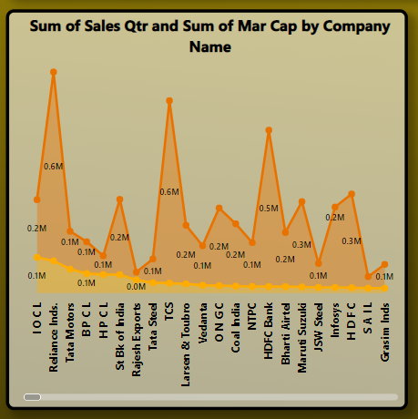
Sales and Market Cap Distribution
INSIGHTS
The stacked area chat shows that companies like Reliance Industries and TCS not only have high market caps but also substantial quarterly sales.
HDFC Banks , ITC, and other major players also show strong performance in both market cap and sales.

Slide 10
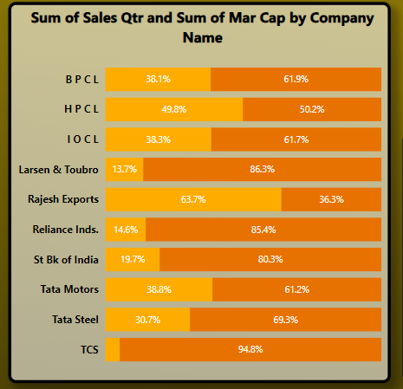
Top 10 industries by Market Caps and Quarterly Sales
INSIGHTS
TCS dominates highest Market caps by 94% followed by Larsen & Toubro (86.3%), Reliance Industries(85.4%)and St BK of India (80.3%).
HPCL has almost 50% of both shares.
Rajesh Exports leads larger share of sales (63.7%) followed by HPCL(Hindustan Petroleum Corporation Limited)is 49.8%.
These companies demonstrate significant quarterly sales, contributing to a total of 593,157 crores.
Their strong sales figures highlight their importance in the market and their robust financial performance.

Slide 11

SUMMARY
Market Leaders: Reliance Industries and TCS are leading in both market capitalization and sales indicating their dominant position in the Indian market.
Sector Dominance: oil & Gas and Technology sectors are particularly strong, with companies like IOCL and TCS showing impressive numbers.
Diversified Performance: While major companies lead the market, a variety of smaller companies also contributes significantly to the series figures, indicating a diversified market landscape. It is better for investing in this top companies.

Slide 12

Thank you

